Slide 1

CYBER ACADEMY
PRESENTATION
12.06.2024

Slide 2
SUPERVISOR
-DR.Dieaa Nasr

Slide 3
TEAM MEMBERS
-Ali Majed
-Ahmed Fayez
-Eslam Atef
-Mohamed Yasser
-Ahmed Ramadan

Slide 4
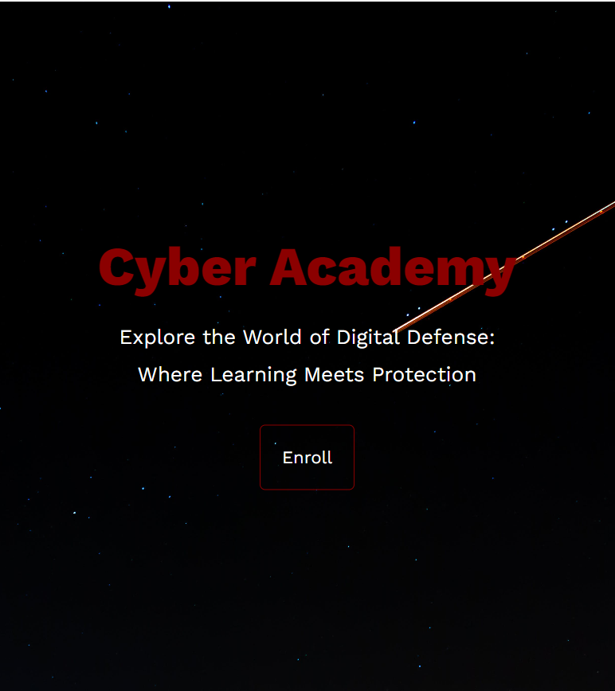
OUTLINES:
-Objective
-What have we used ?
-Overview

Slide 5
OBJECTIVES
Given the many vulnerabilities in the world
In particular, website vulnerabilities
And because of the importance of ethical hacking at the present time

Slide 6
OBJECTIVES
We aim to teach anyone who is Ethical hacking and how to detect different vulnerabilities and also how to protect any website from this vulnerability.

Slide 7




WHAT HAVE WE USED ?
HTML
CSS
JAVASCRIPT
PHP

Slide 8


WHAT HAVE WE USED ?
Python
Pytorch

Slide 9
OVERVIEW.

Slide 10
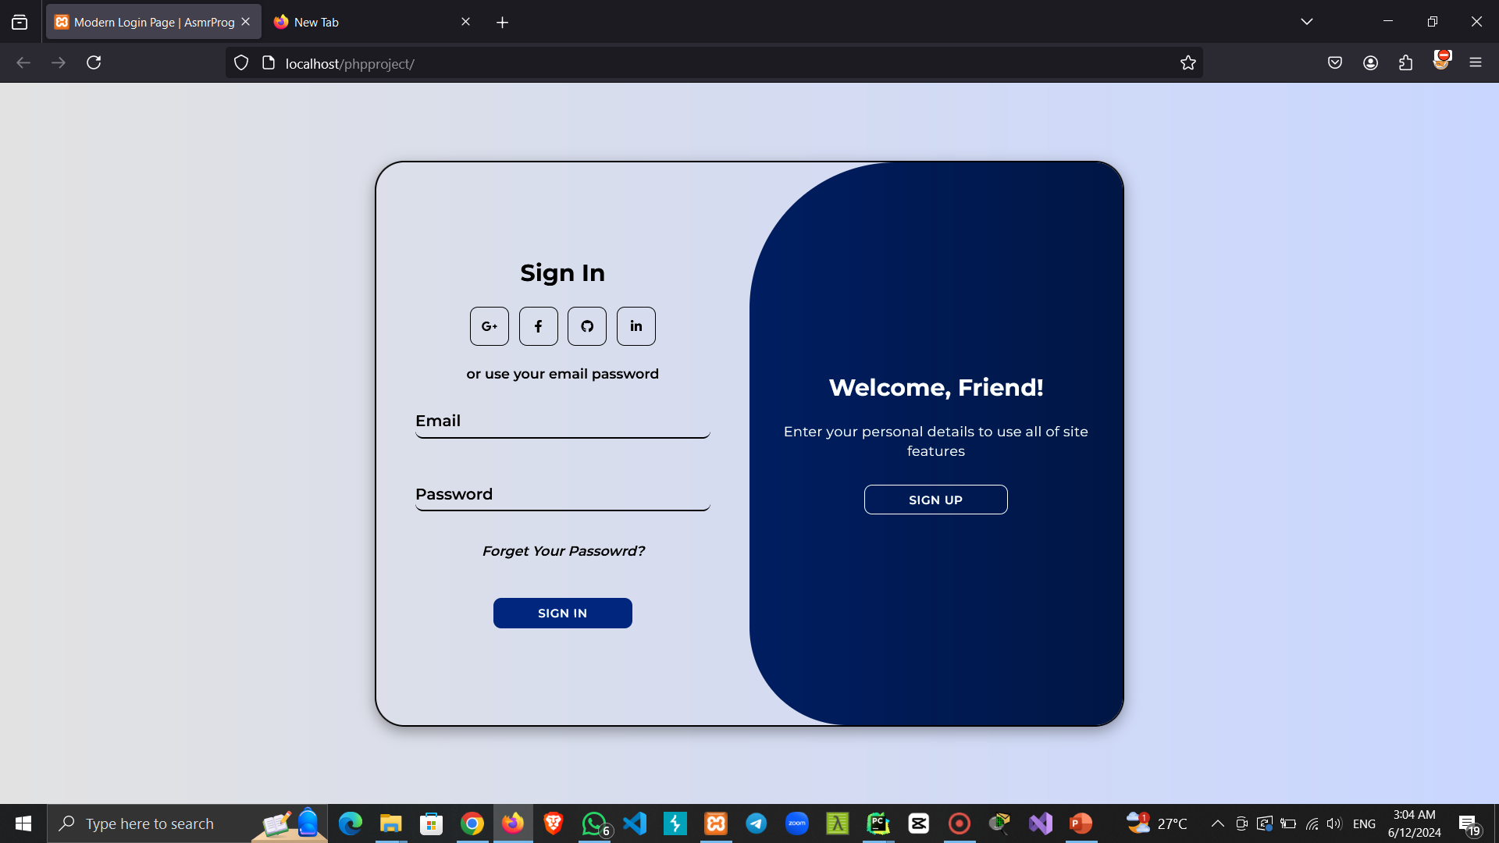

Slide 11
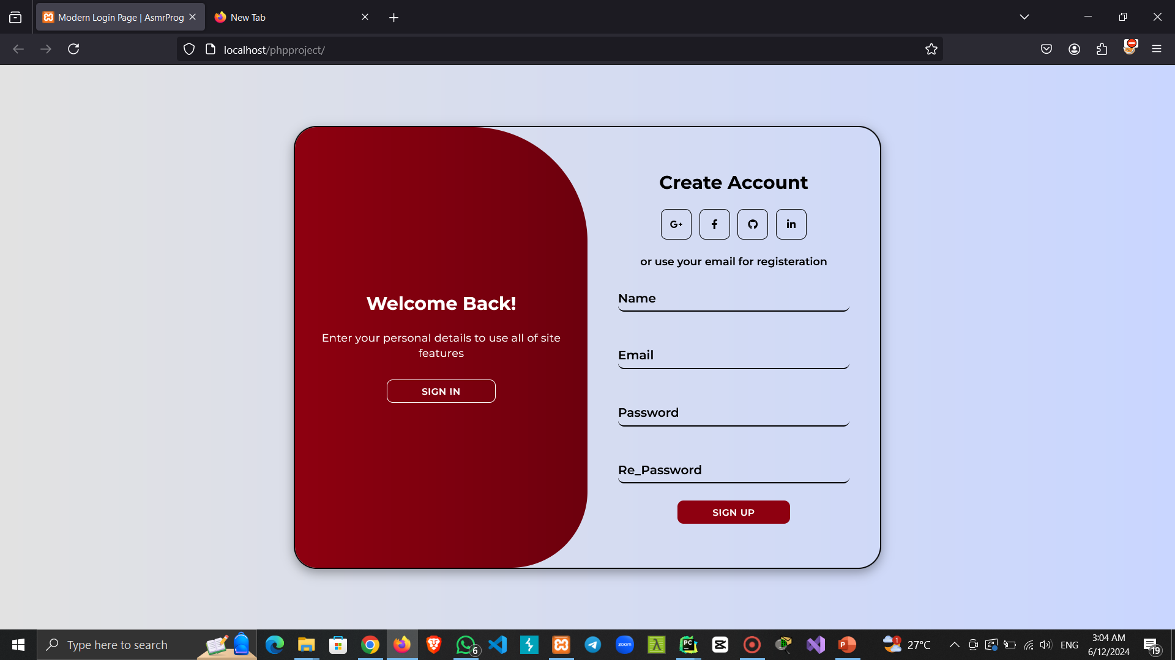

Slide 12
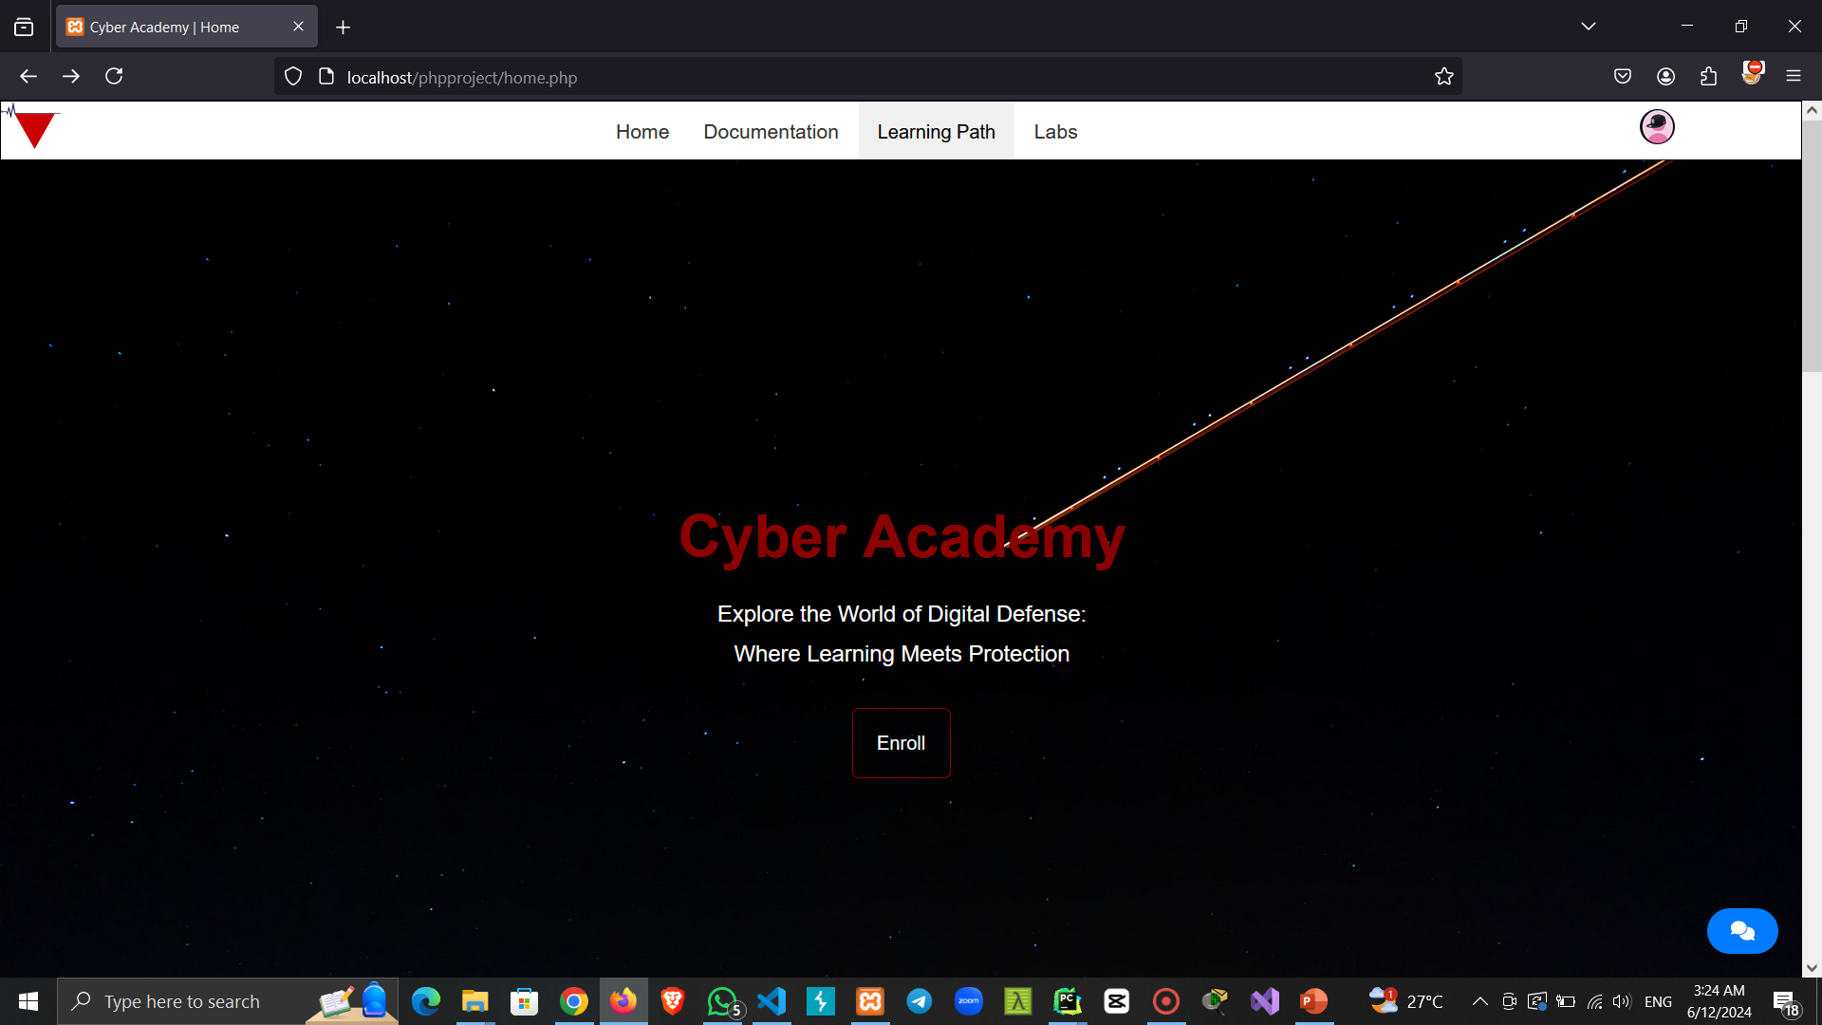

Slide 13
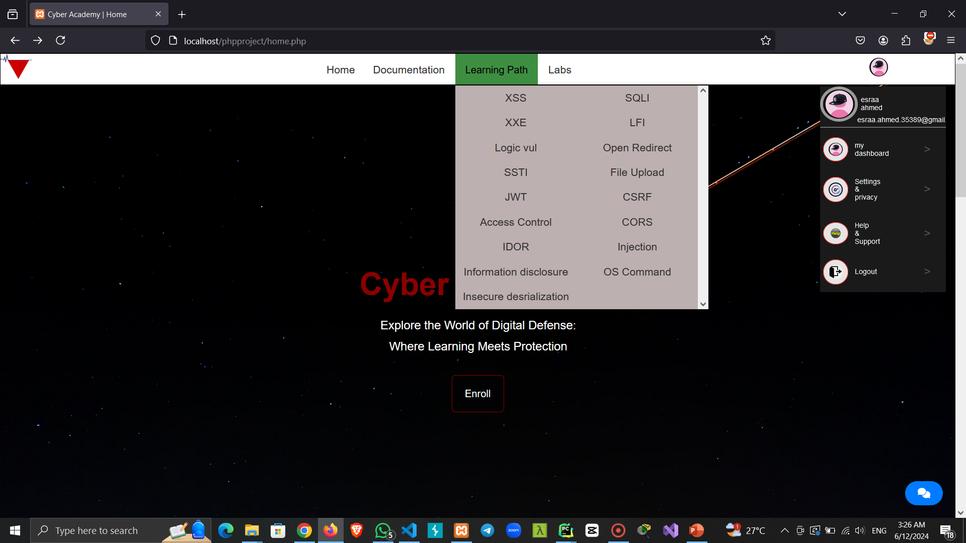

Slide 14
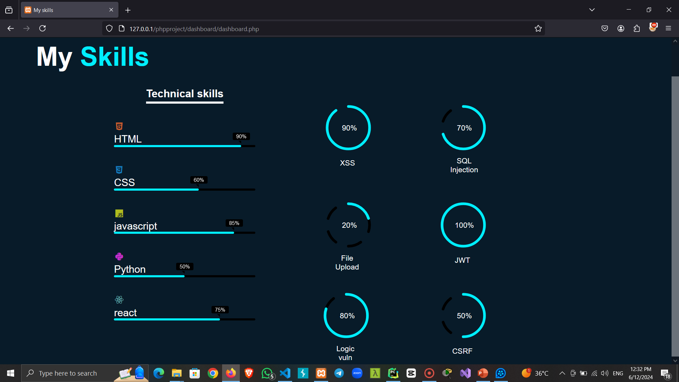

Slide 15
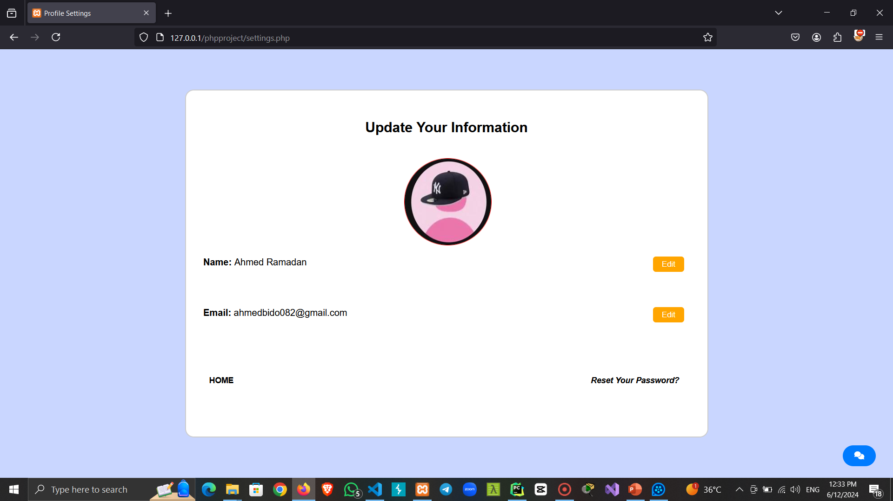

Slide 16
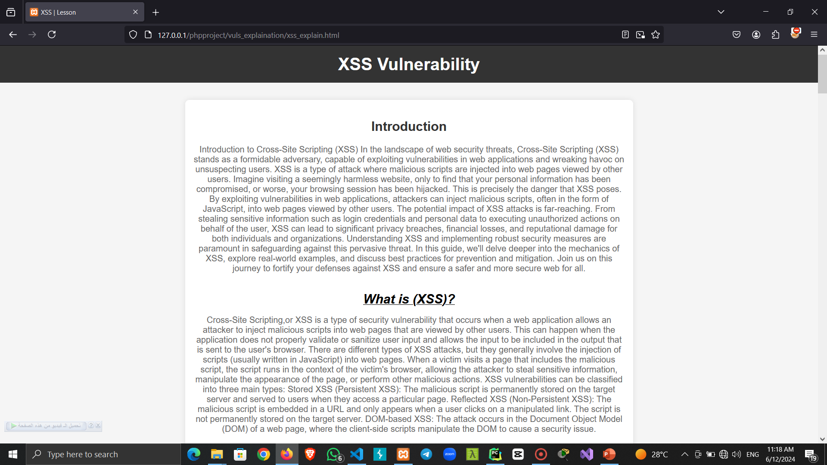

Slide 17
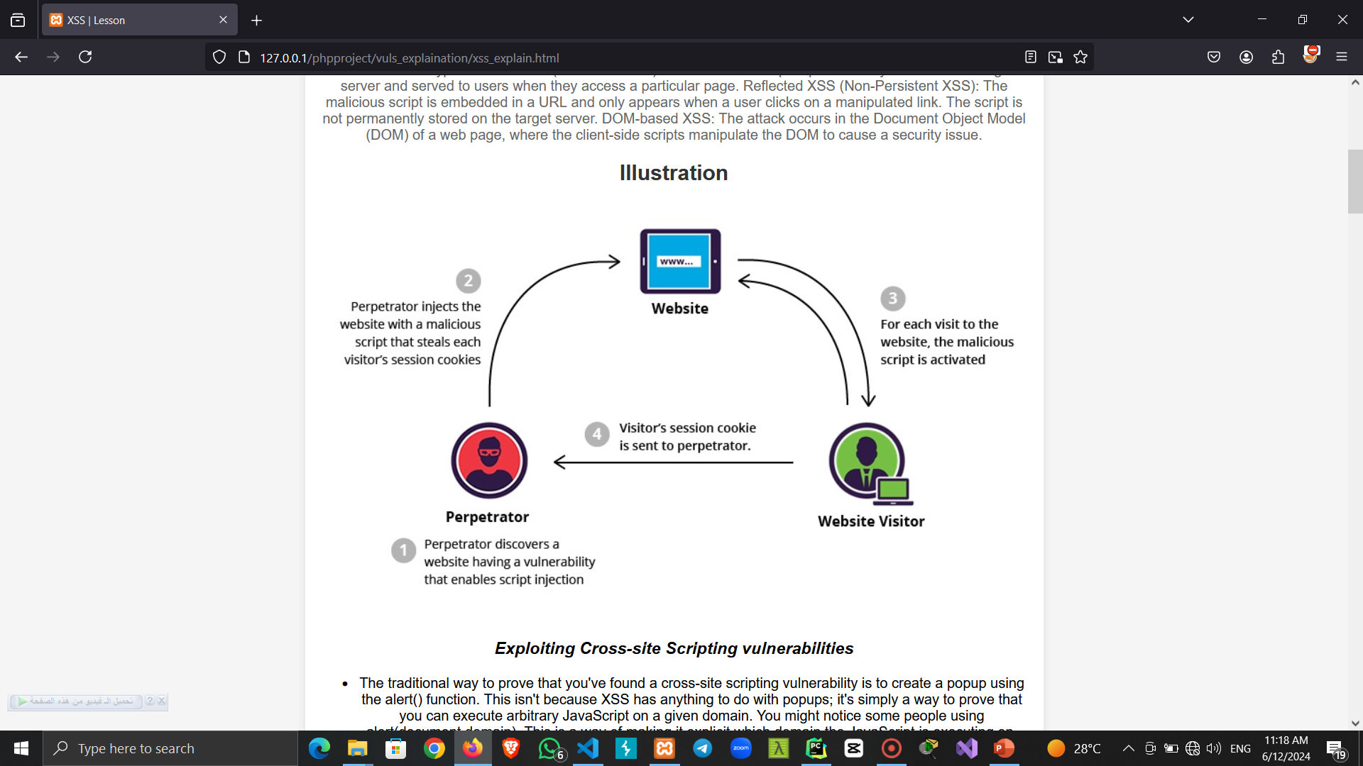

Slide 18
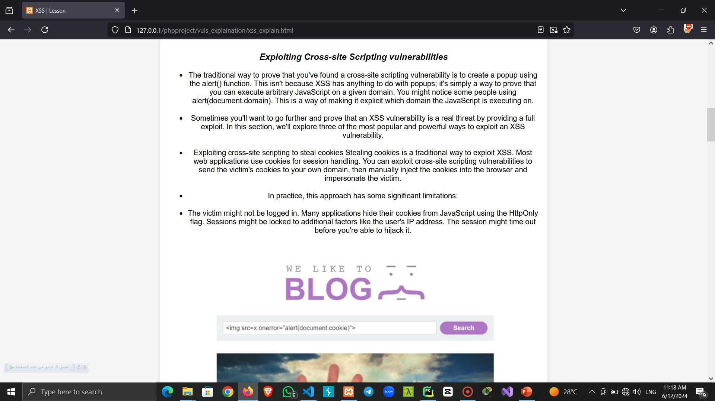

Slide 19
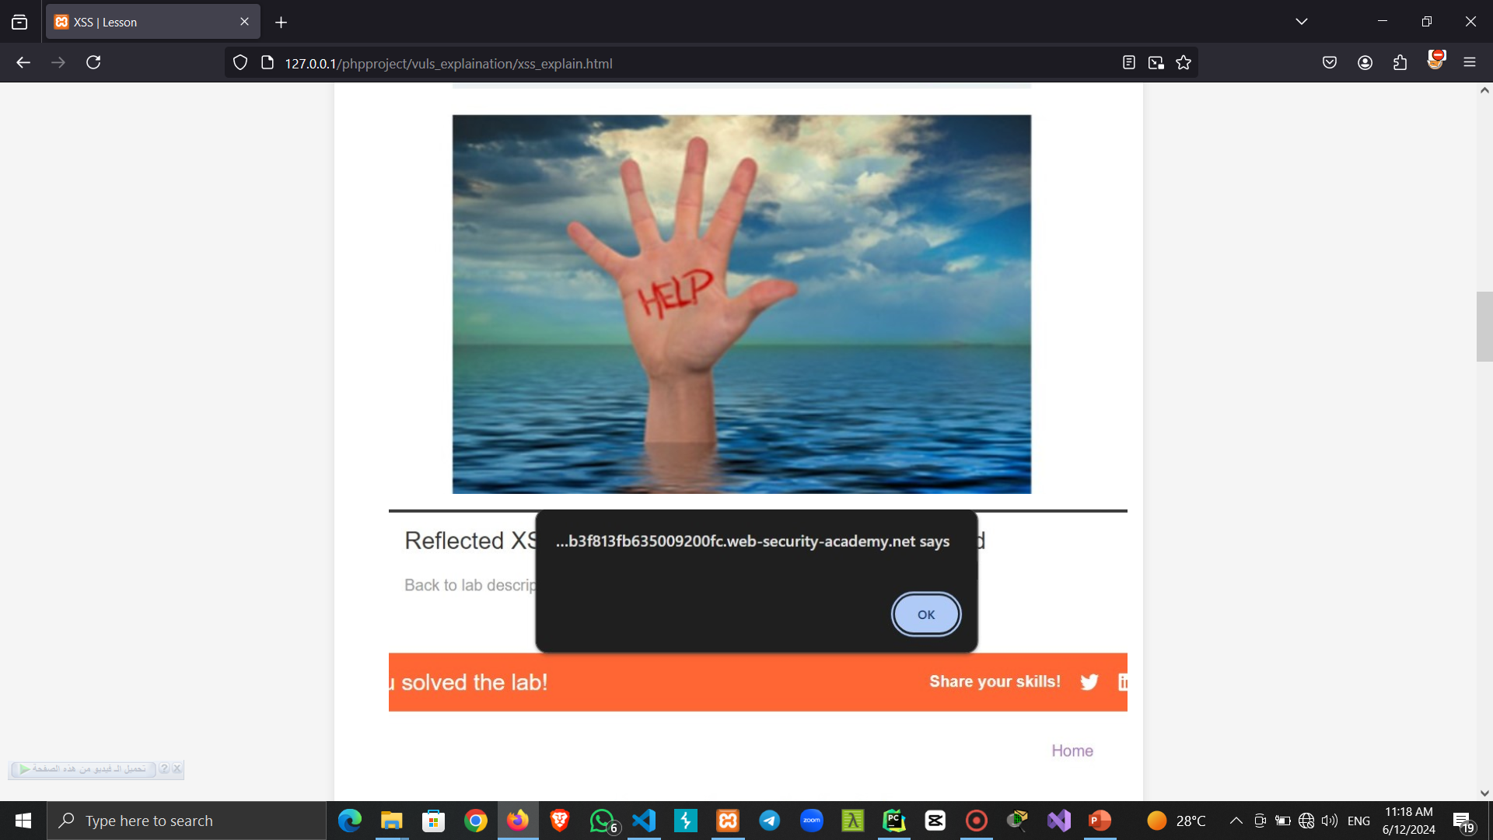

Slide 20
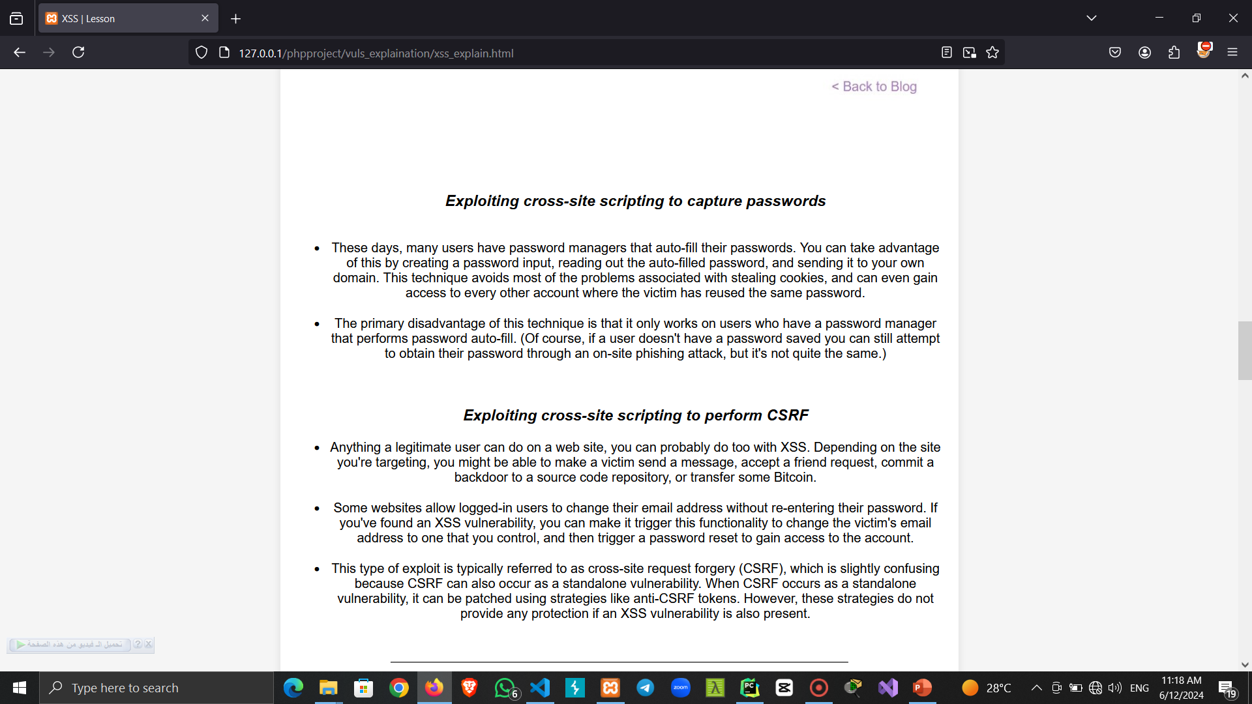

Slide 21
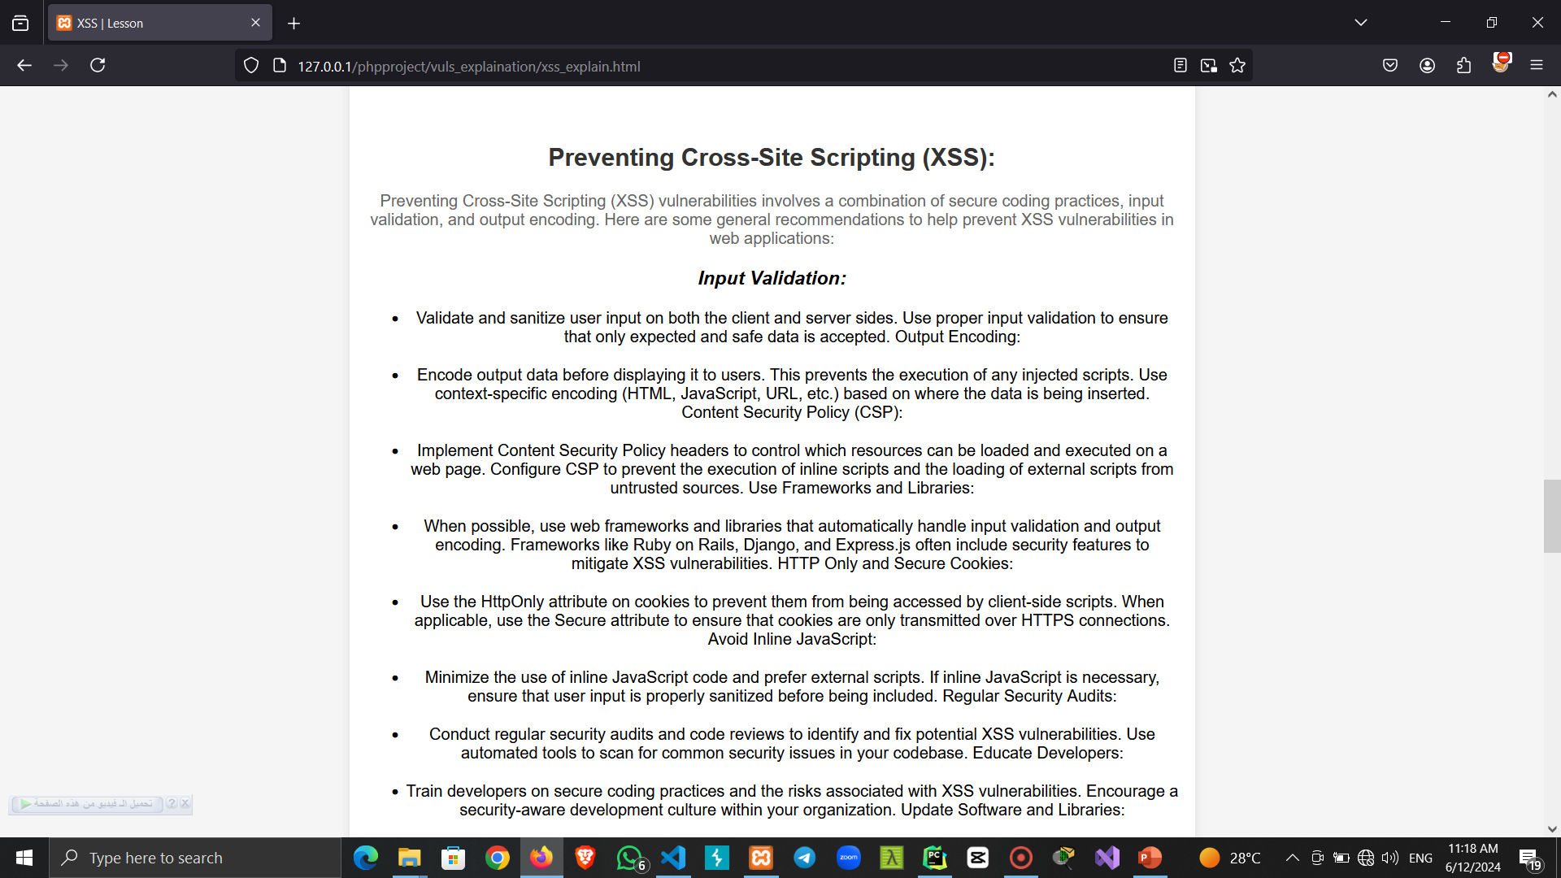

Slide 22
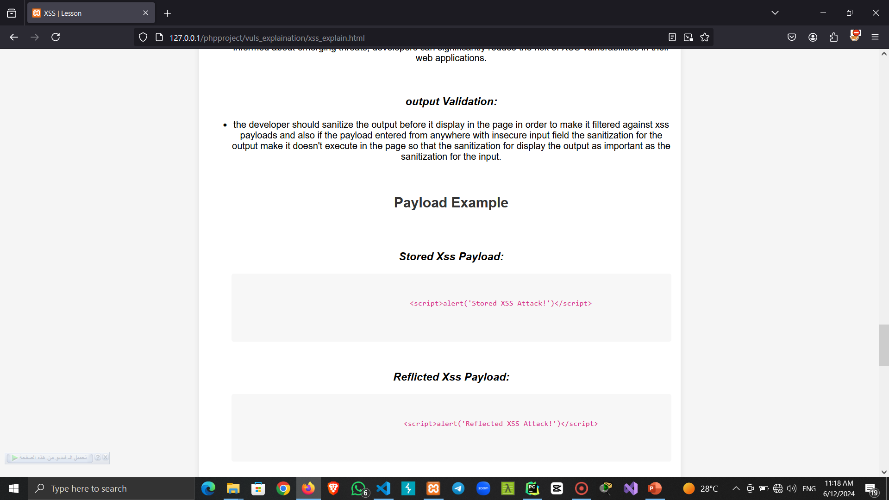

Slide 23
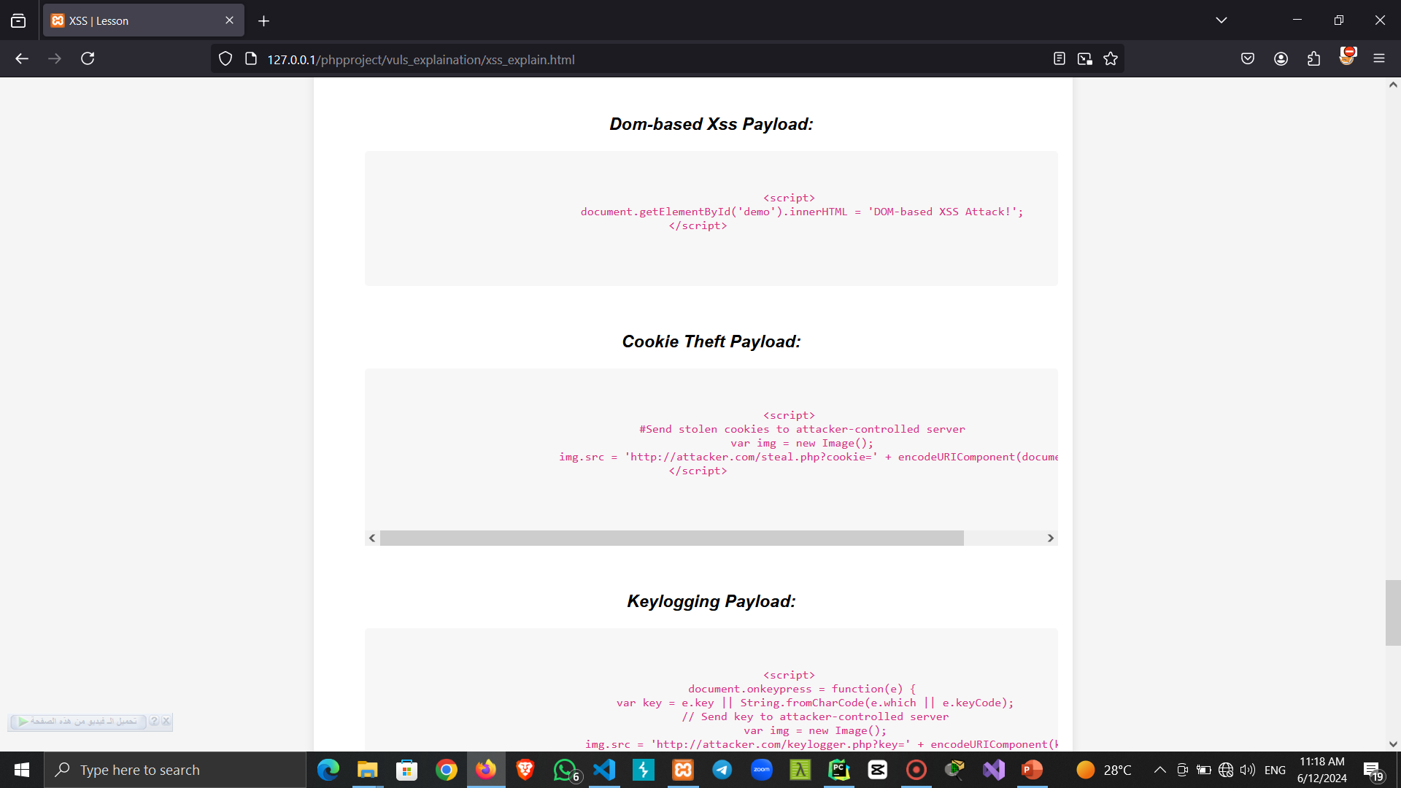

Slide 24
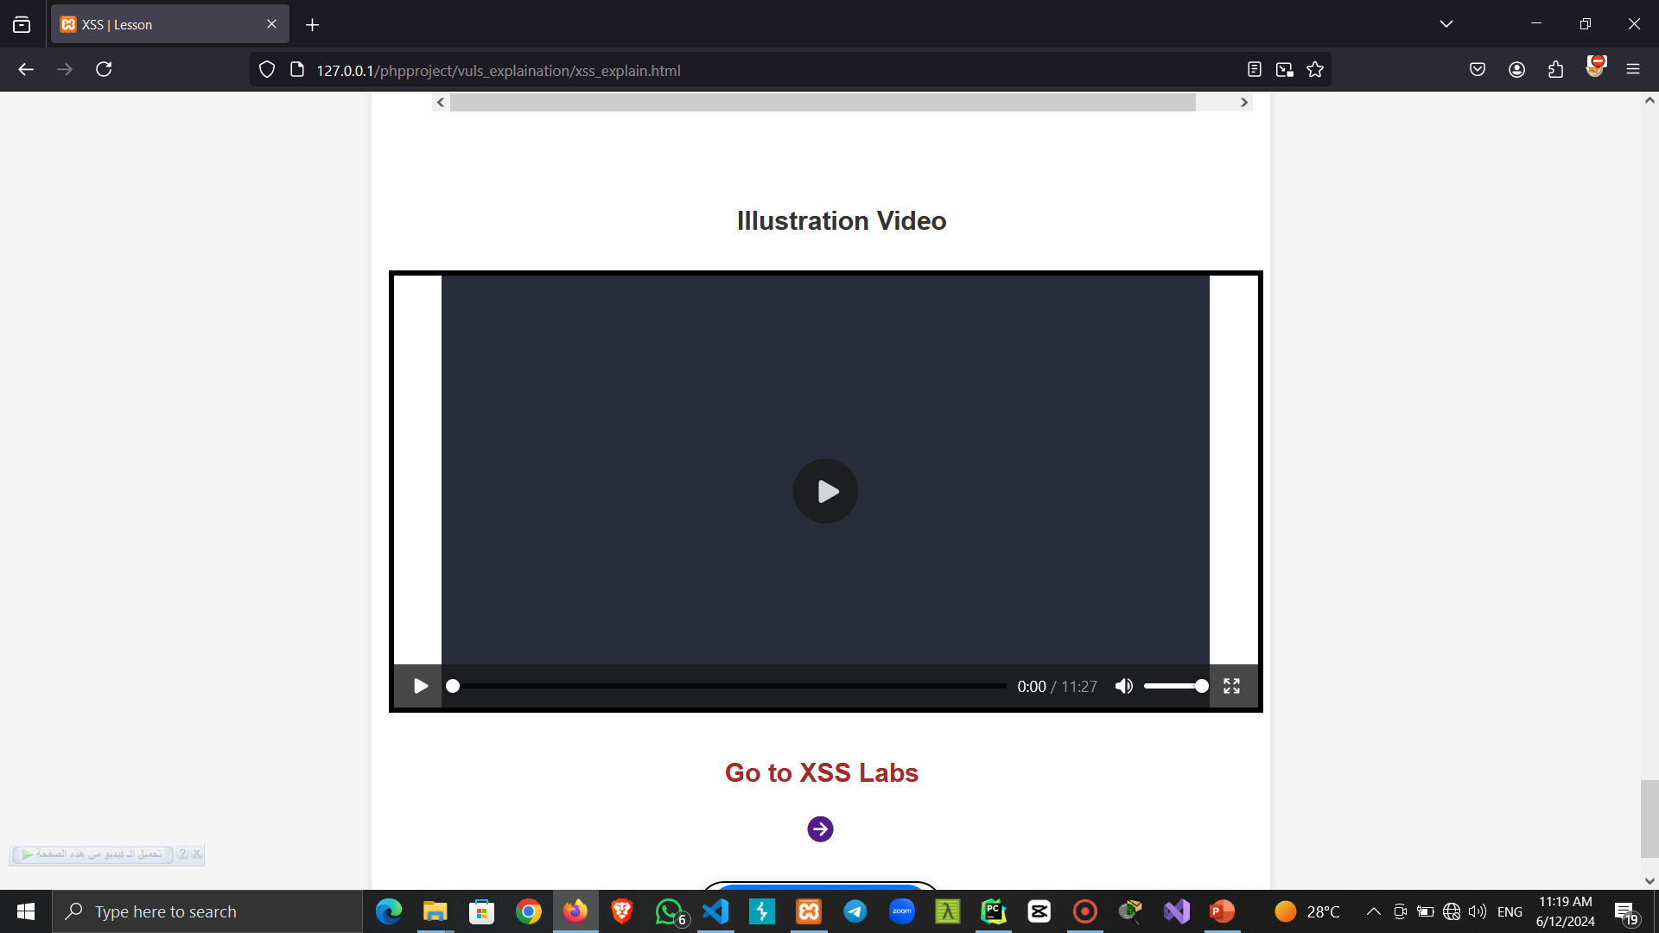

Slide 25
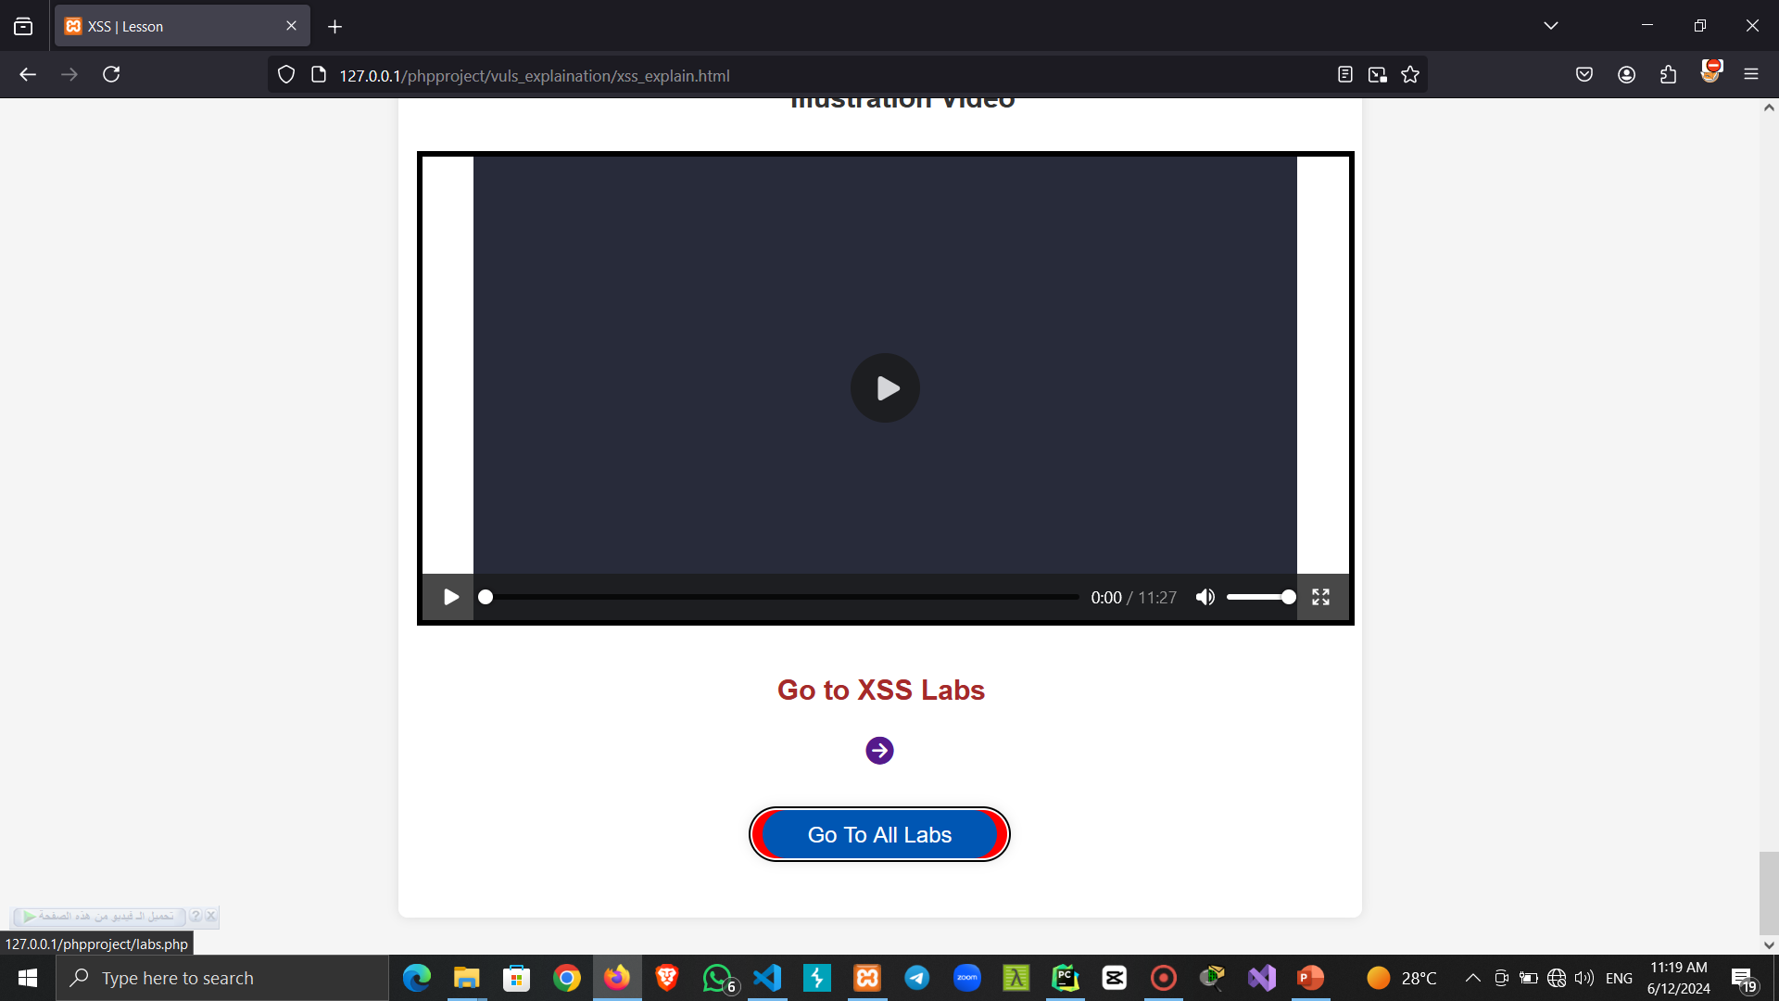

Slide 26
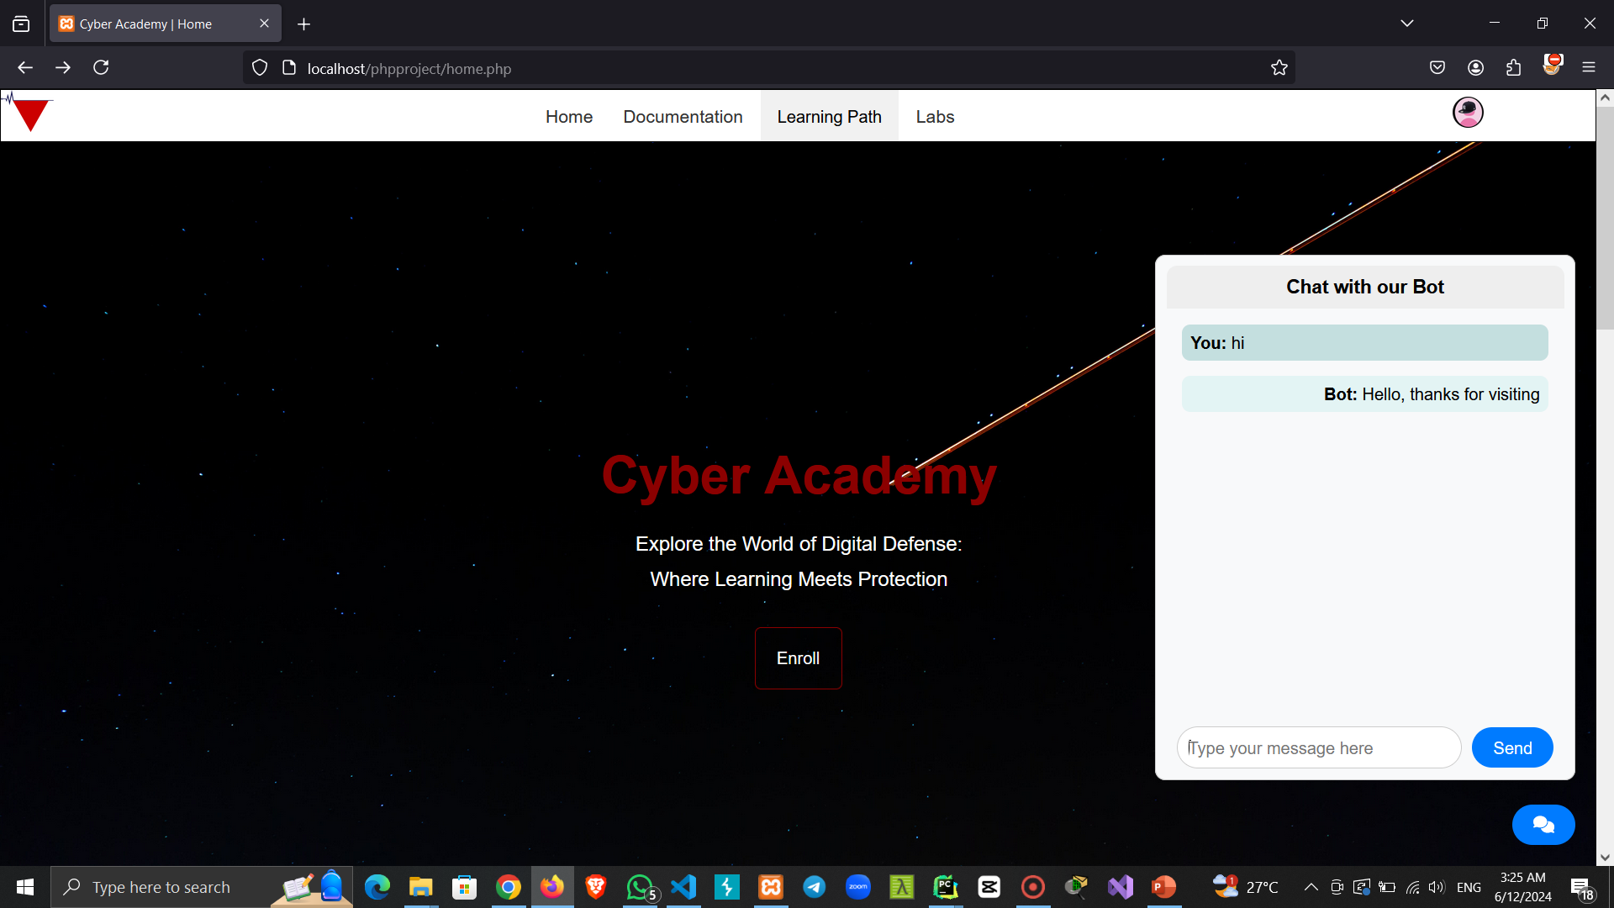

Slide 27
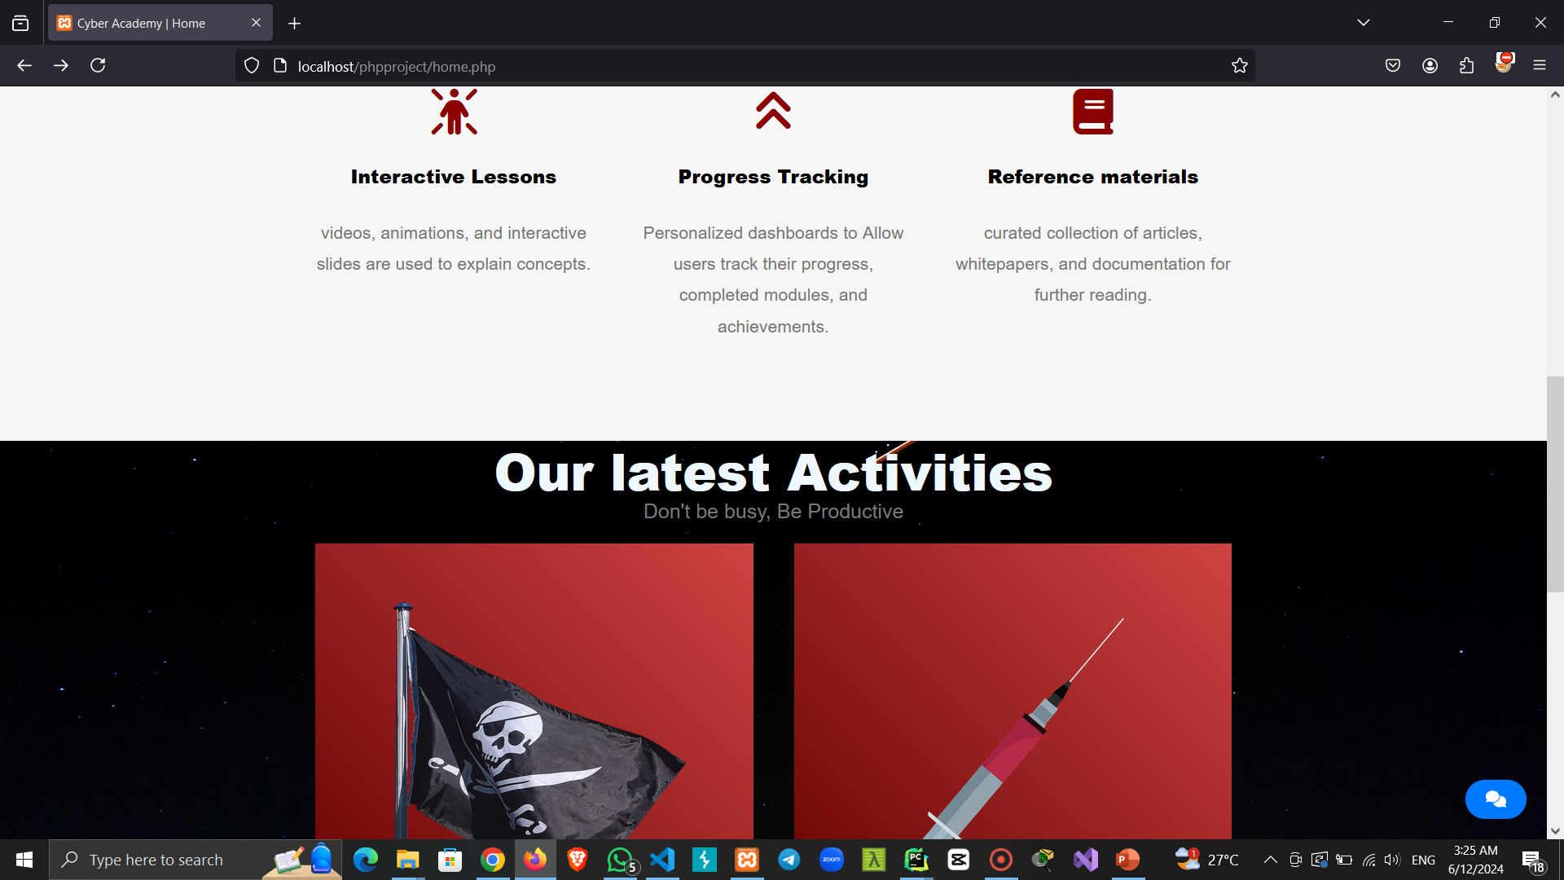

Slide 28
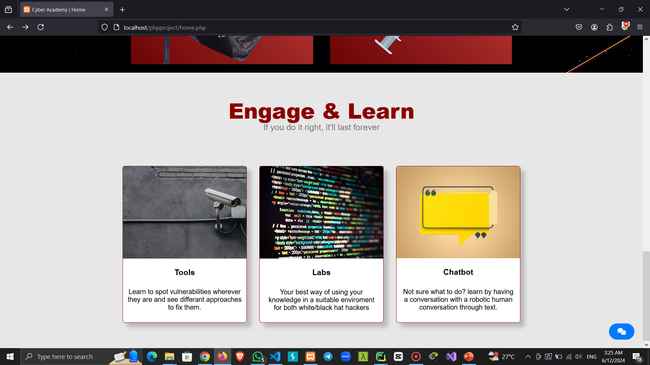

Slide 29
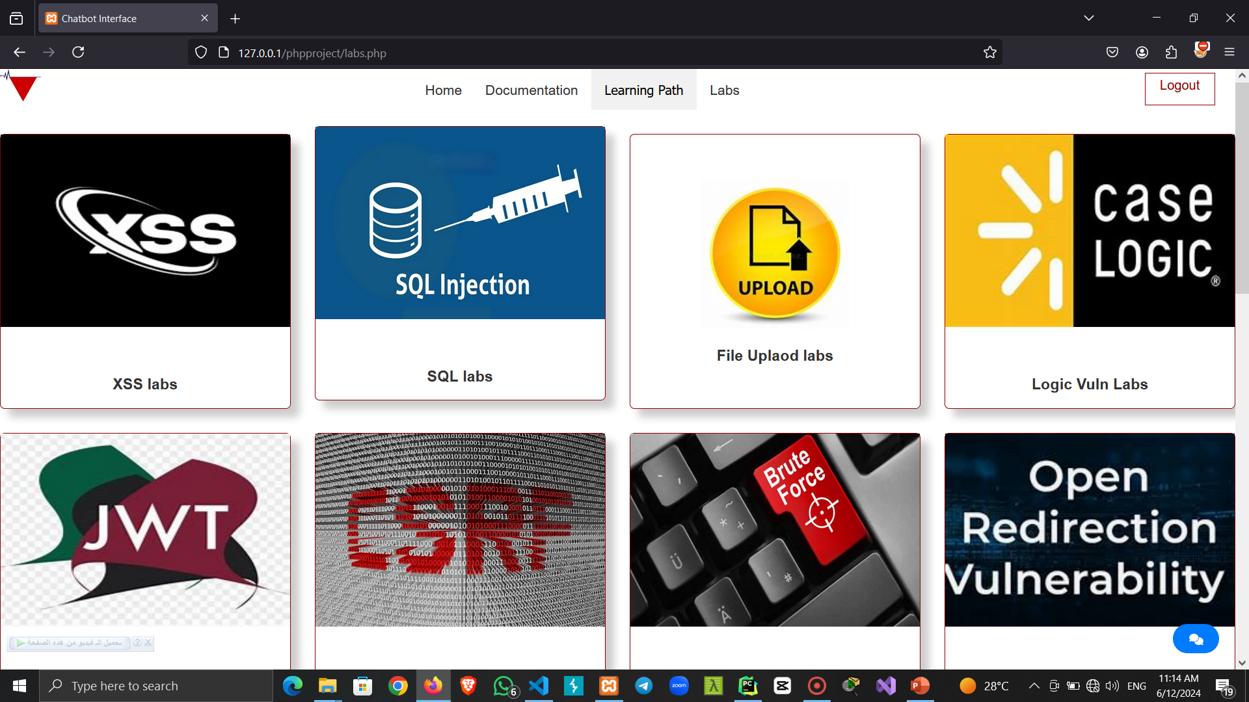

Slide 30
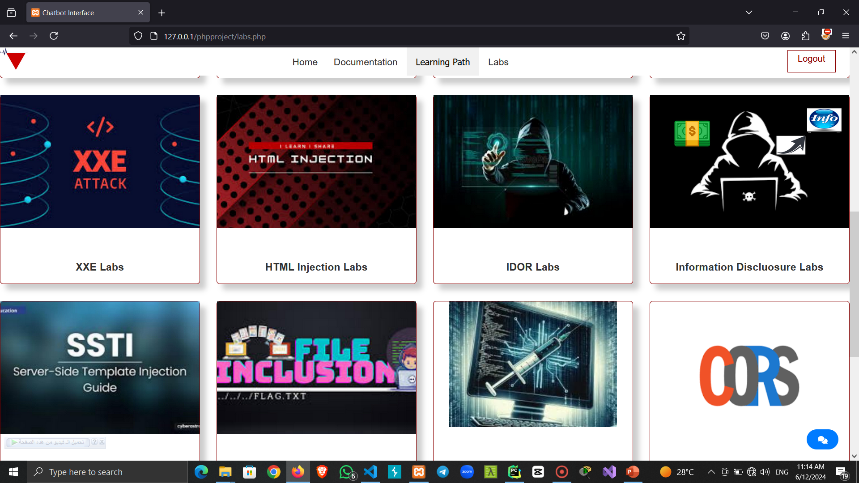

Slide 31
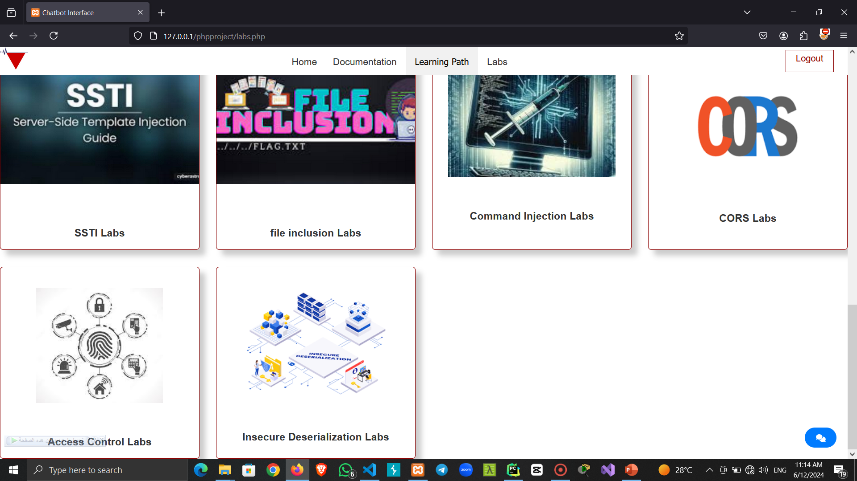

Slide 32
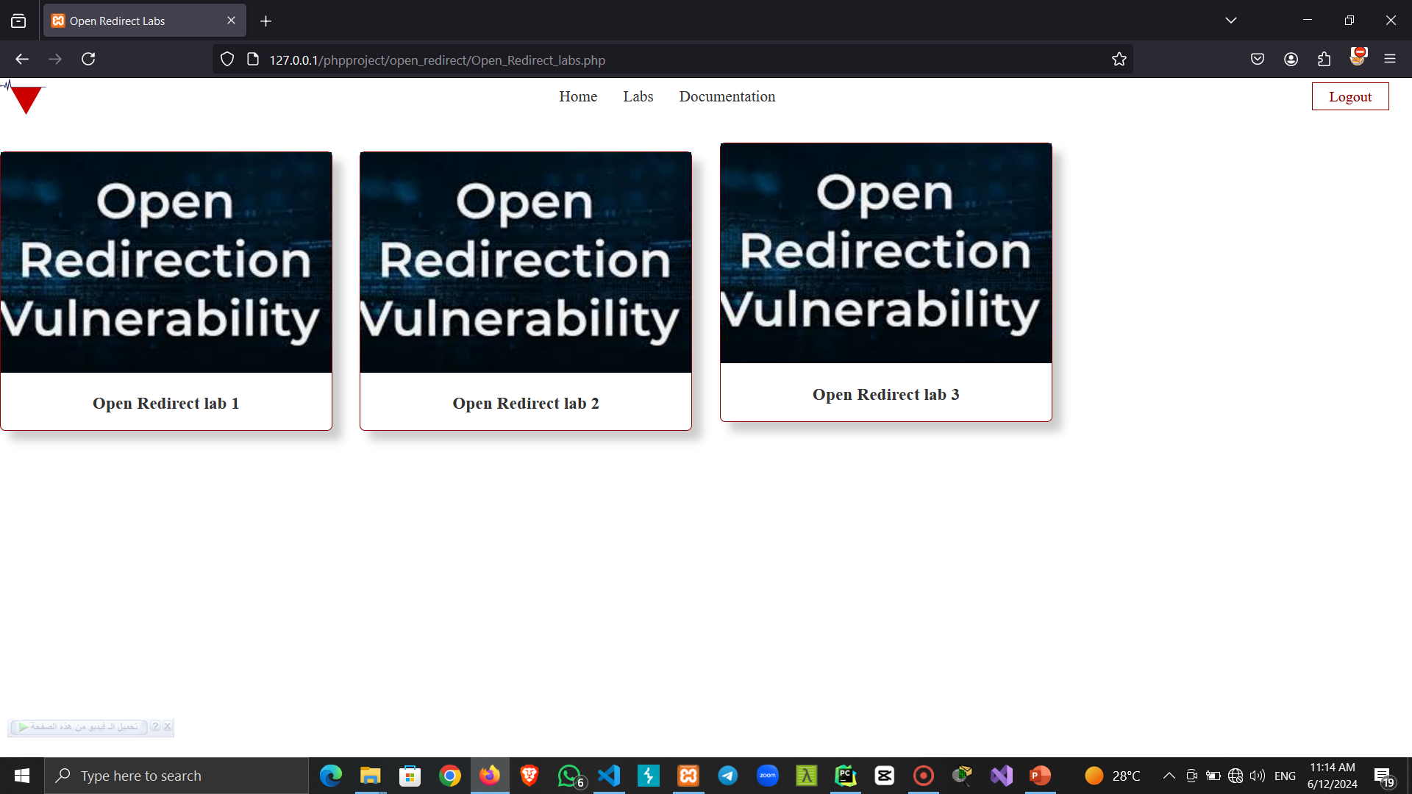

Slide 33
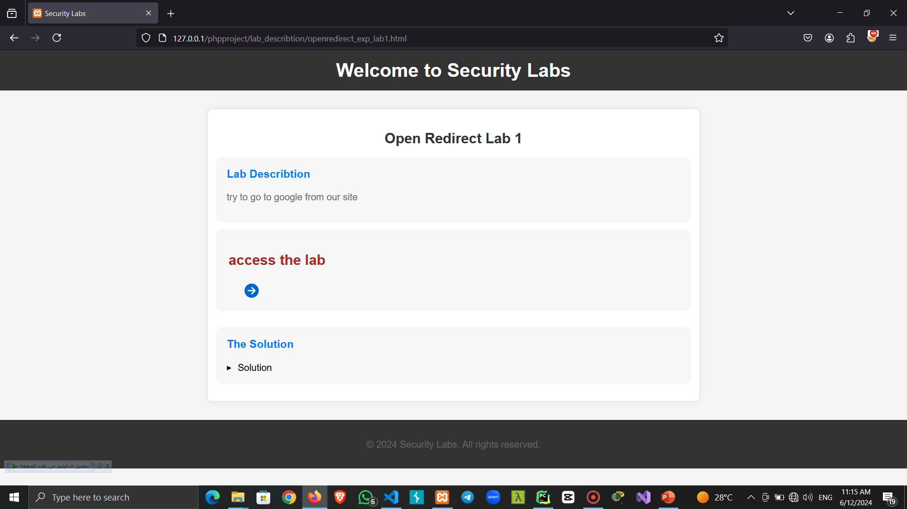

Slide 34
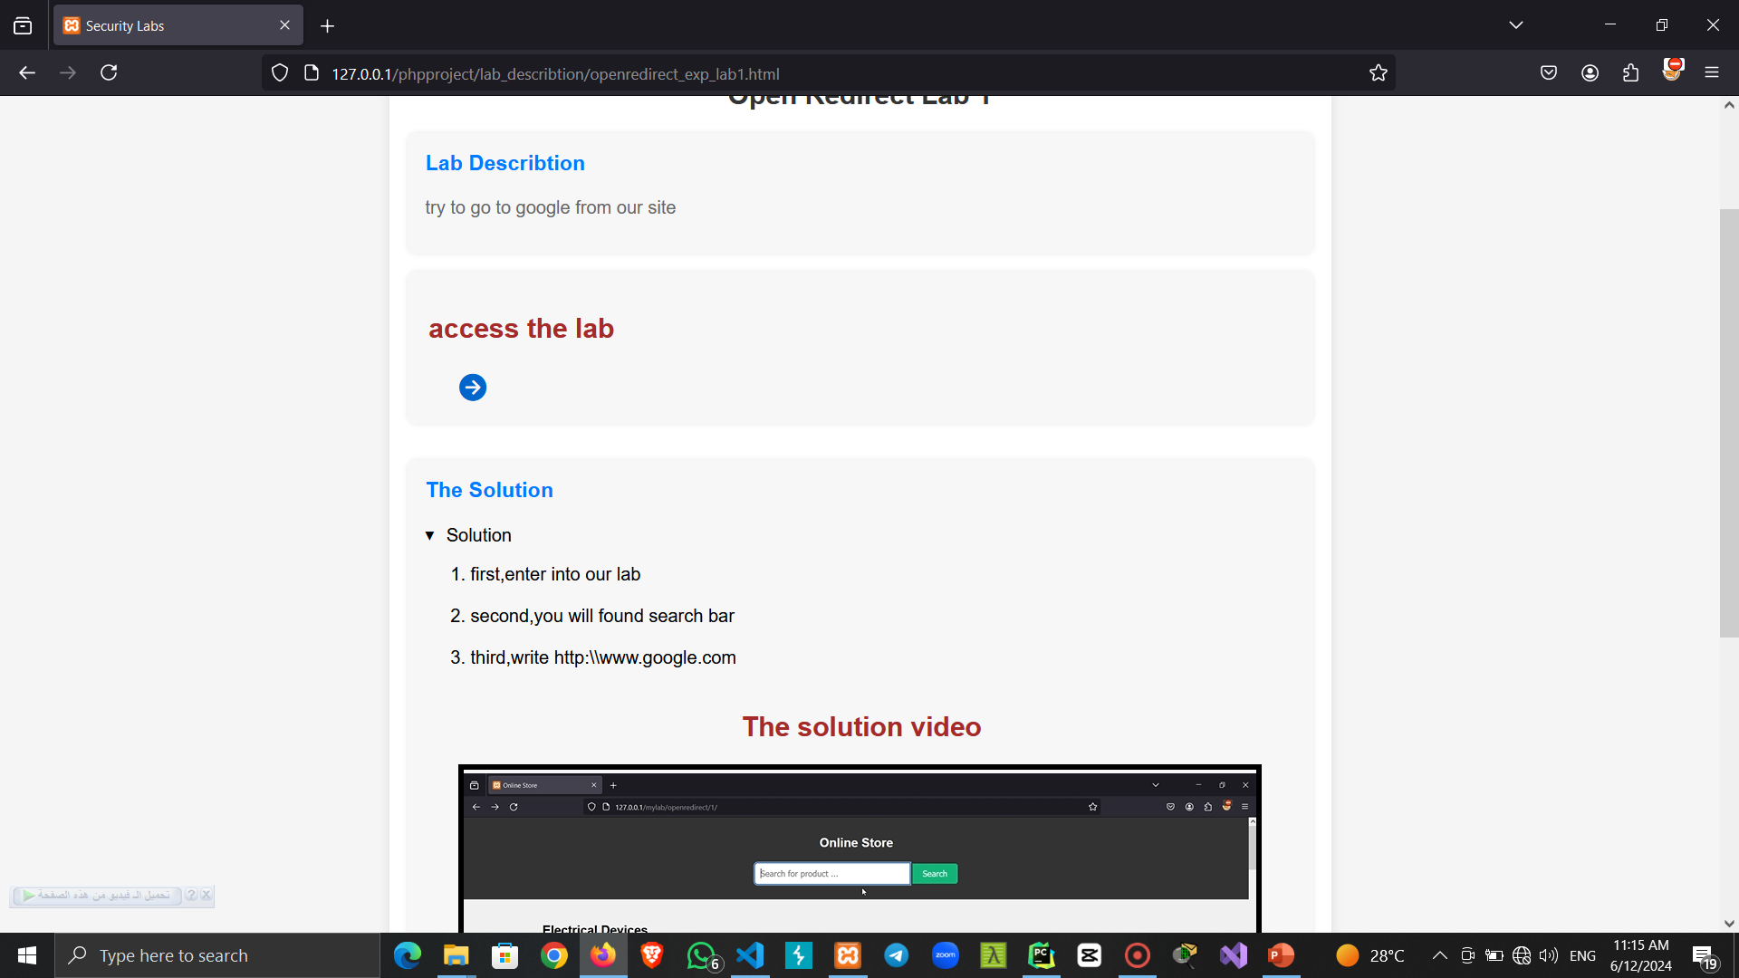

Slide 35
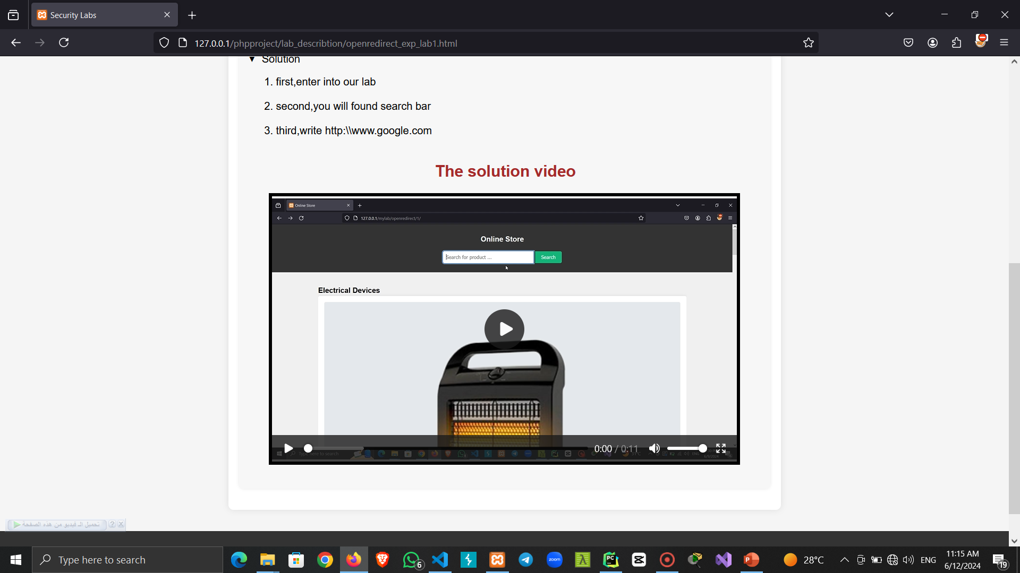

Slide 36
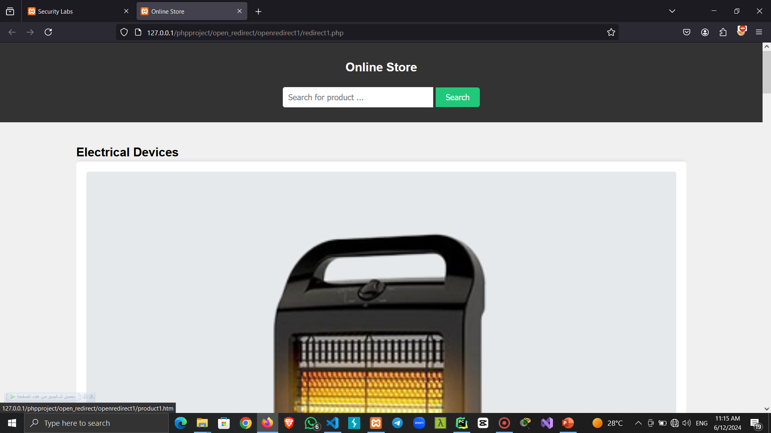

Slide 37
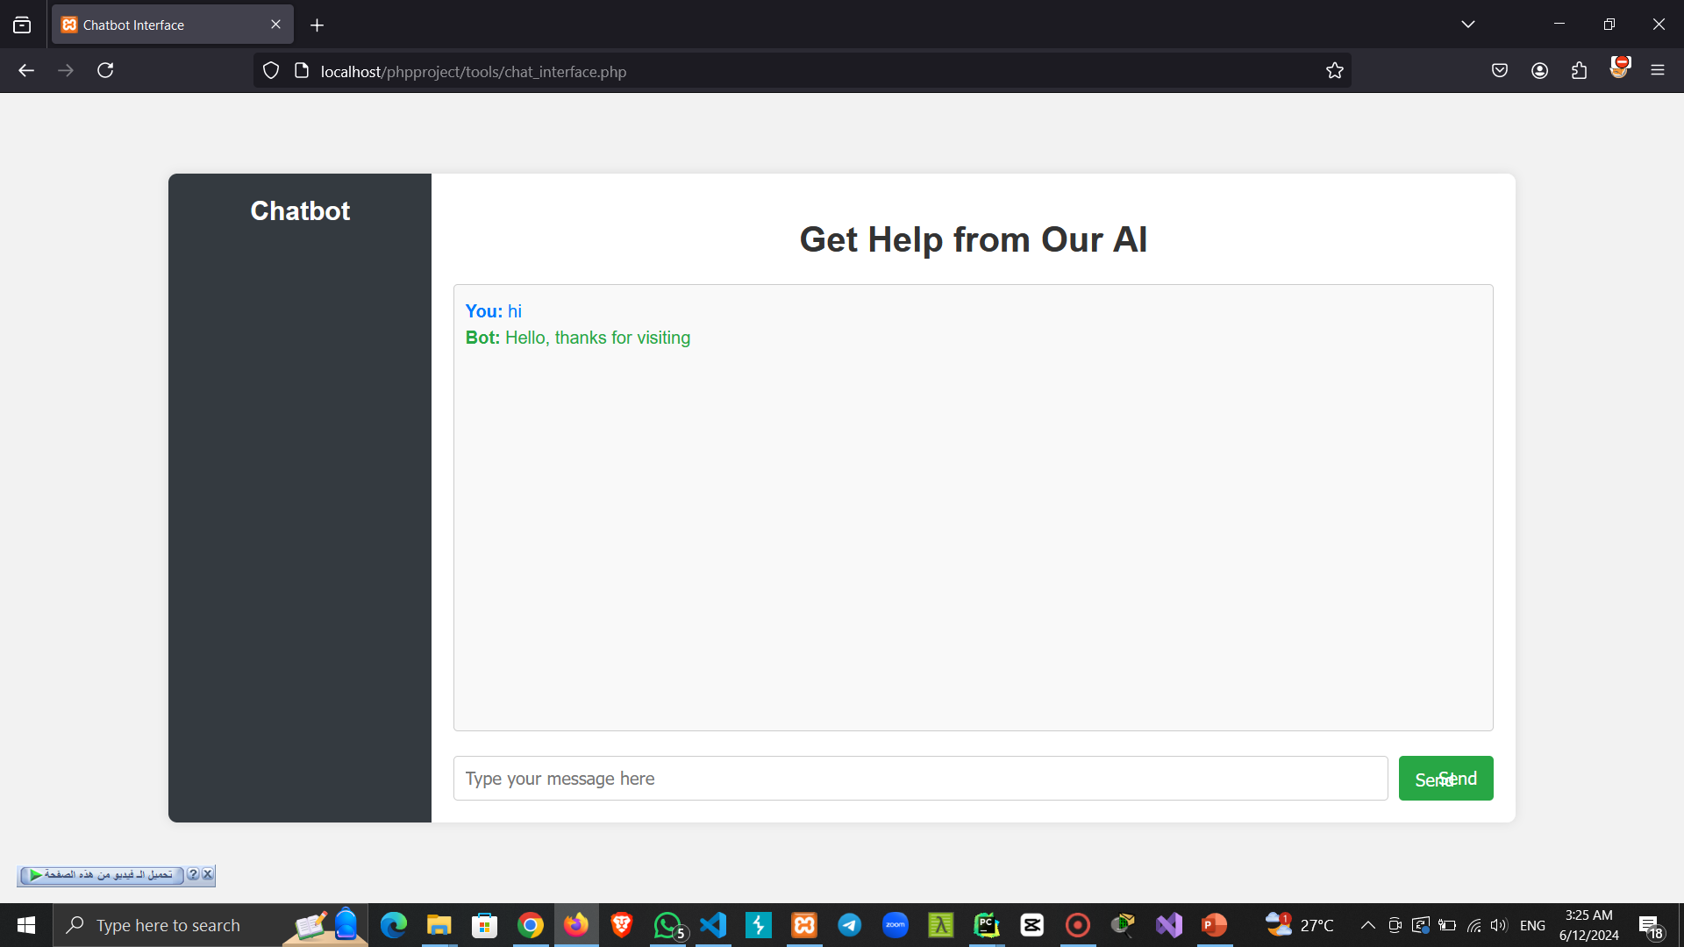

Slide 38
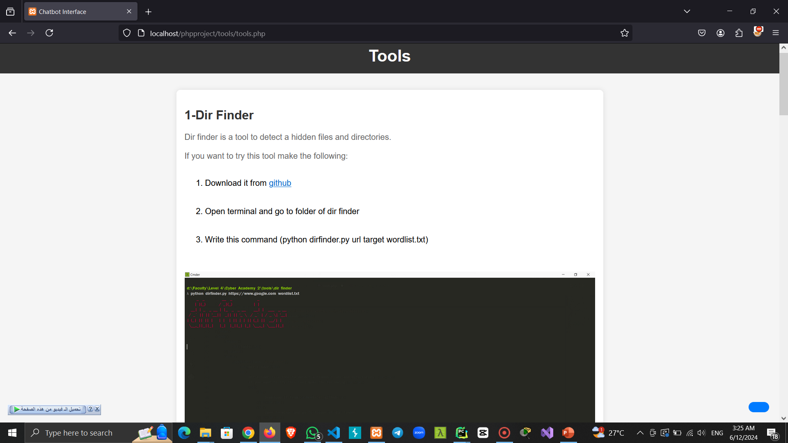

Slide 39
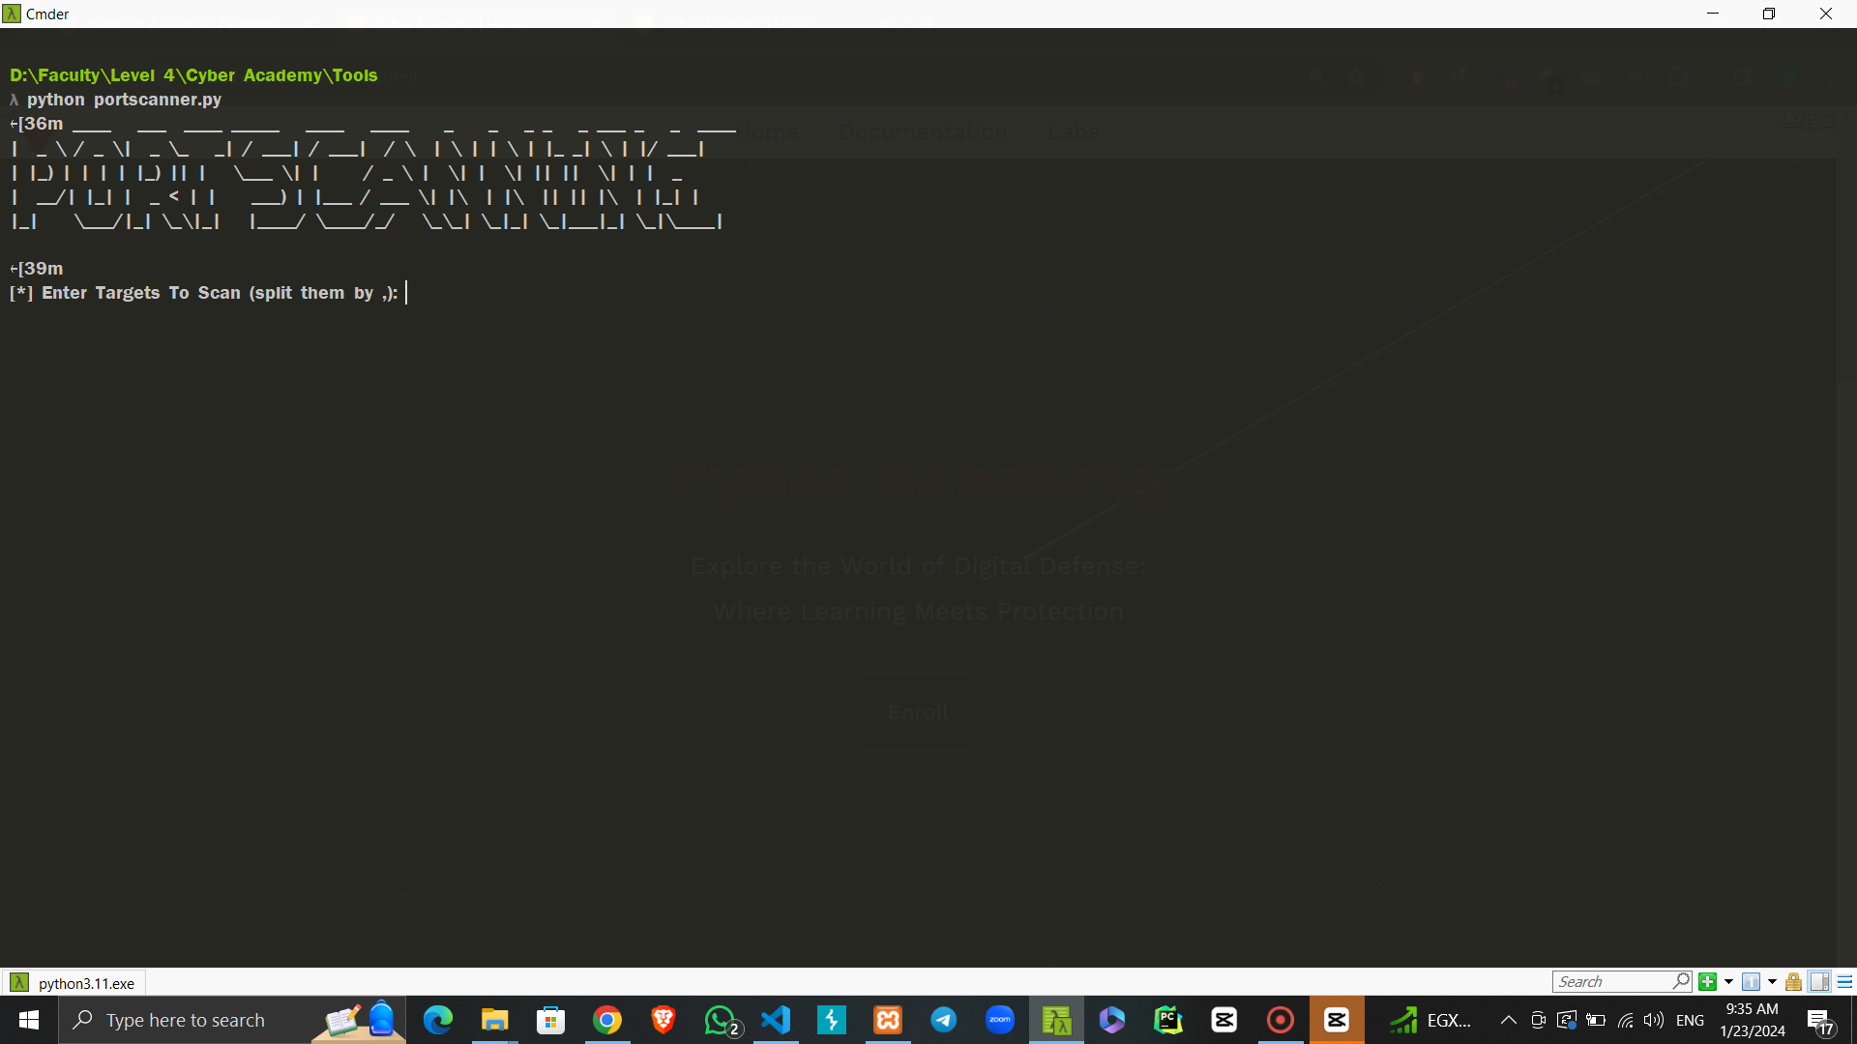

Slide 40
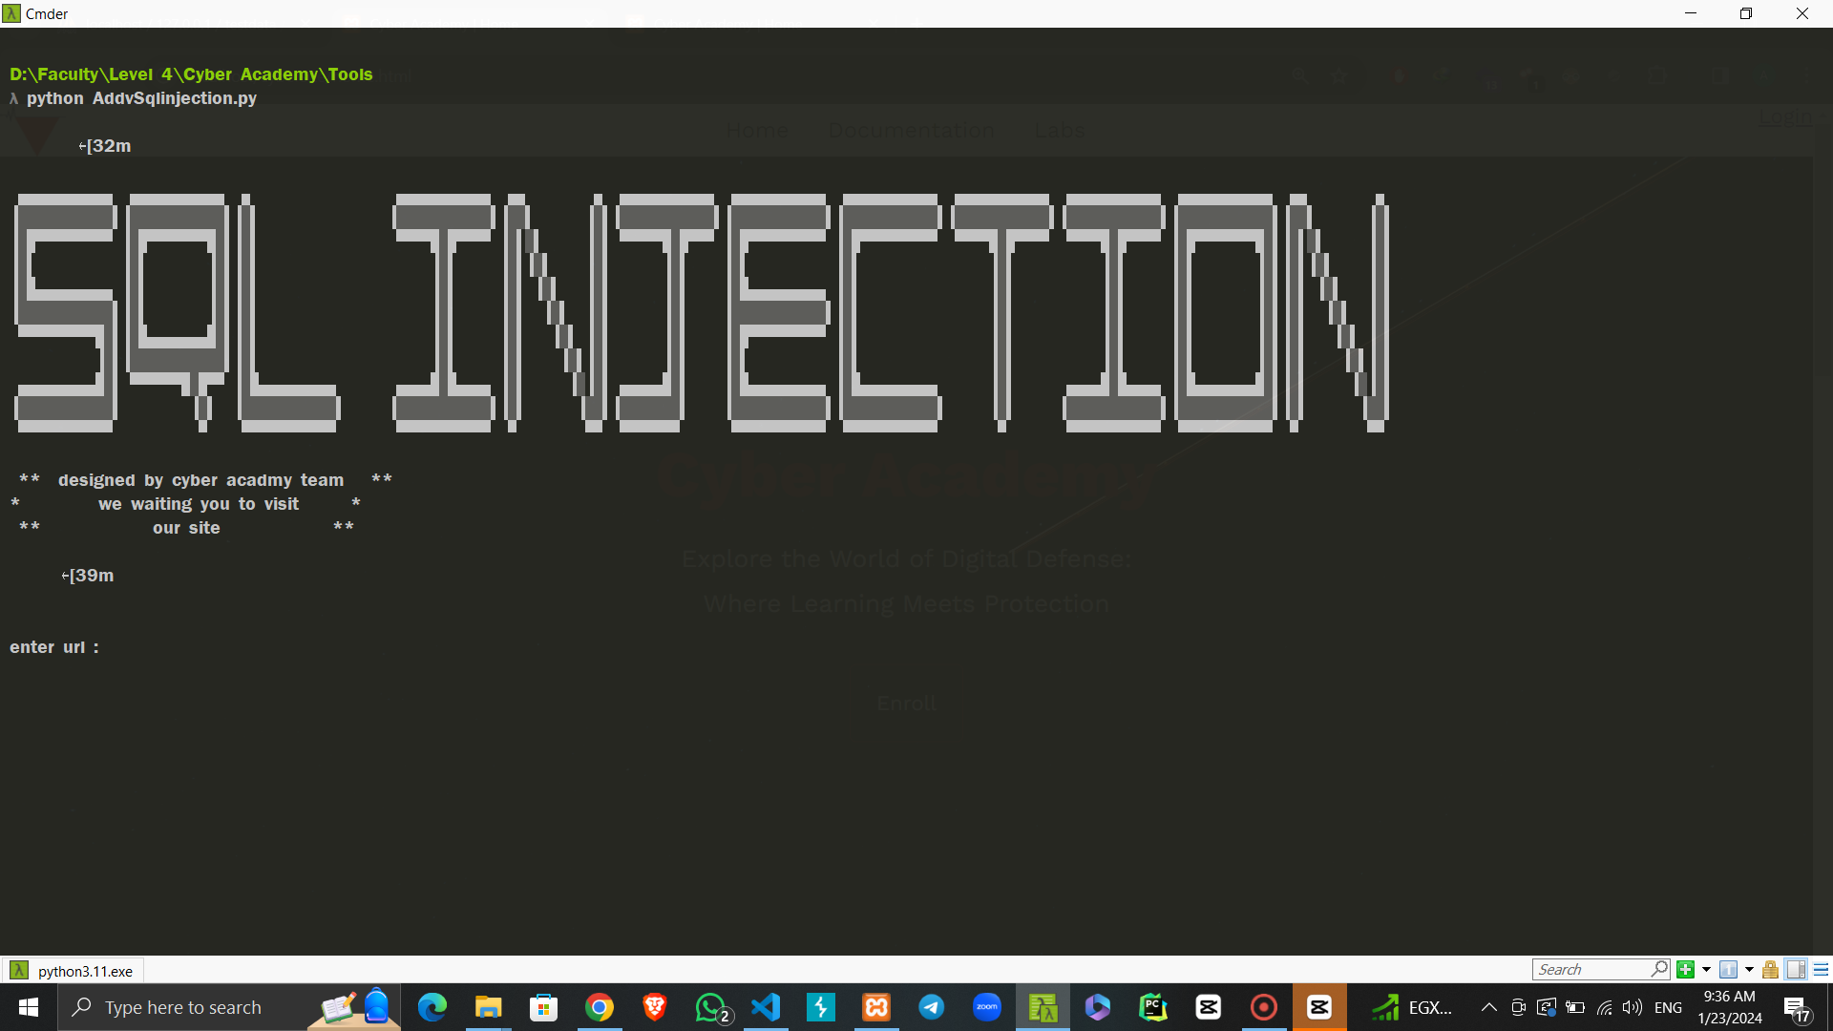

Slide 41
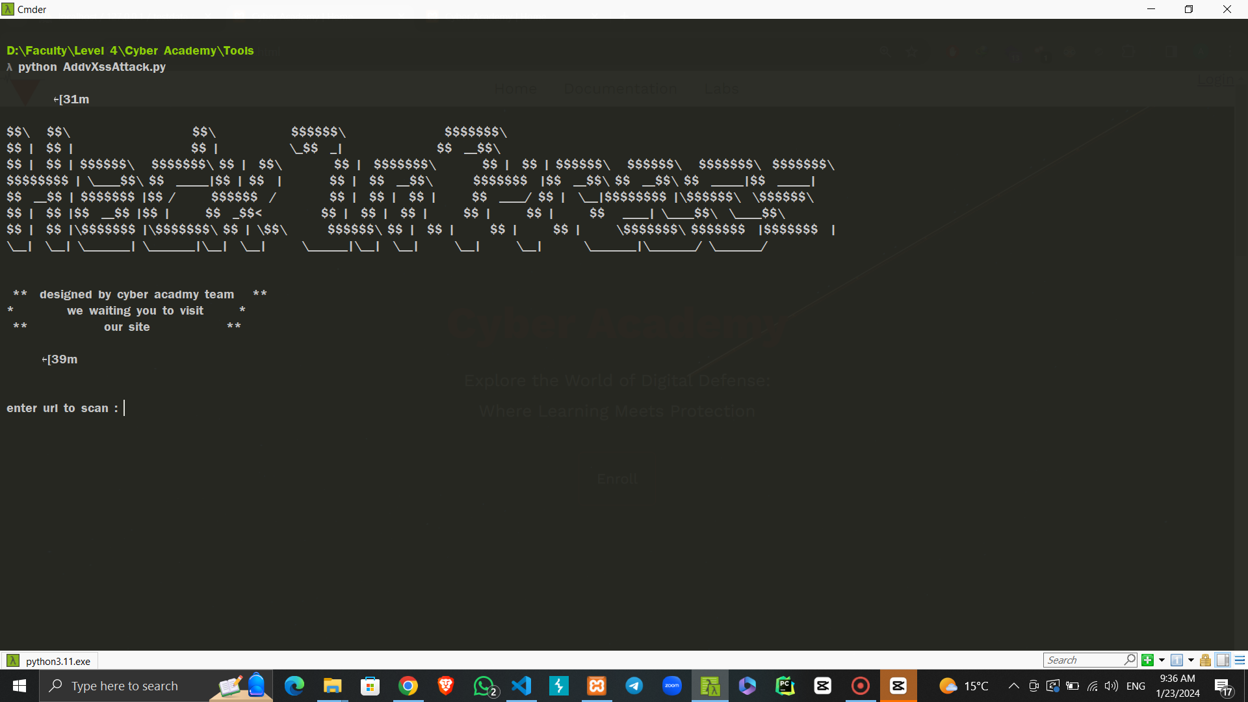

Slide 42
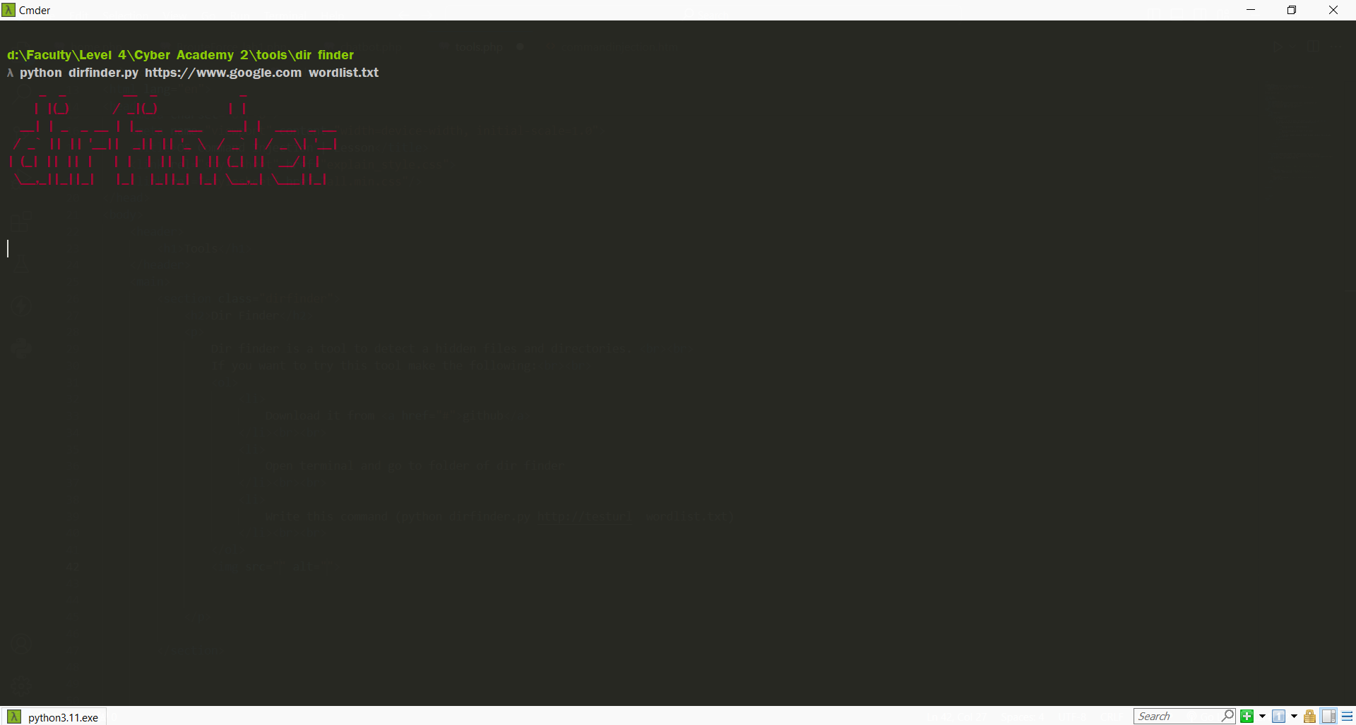

Slide 43
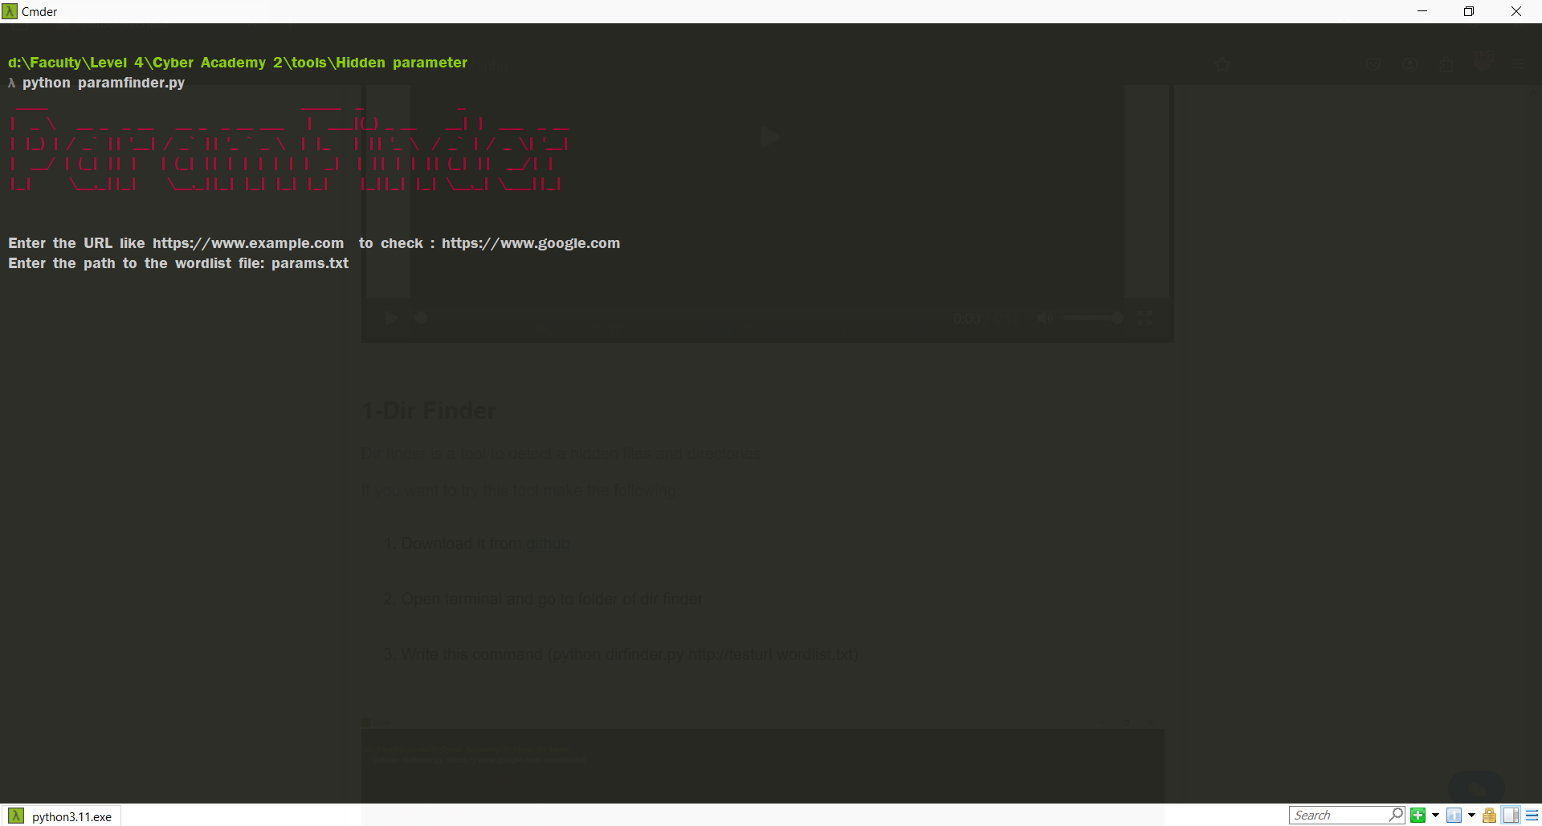

Slide 44
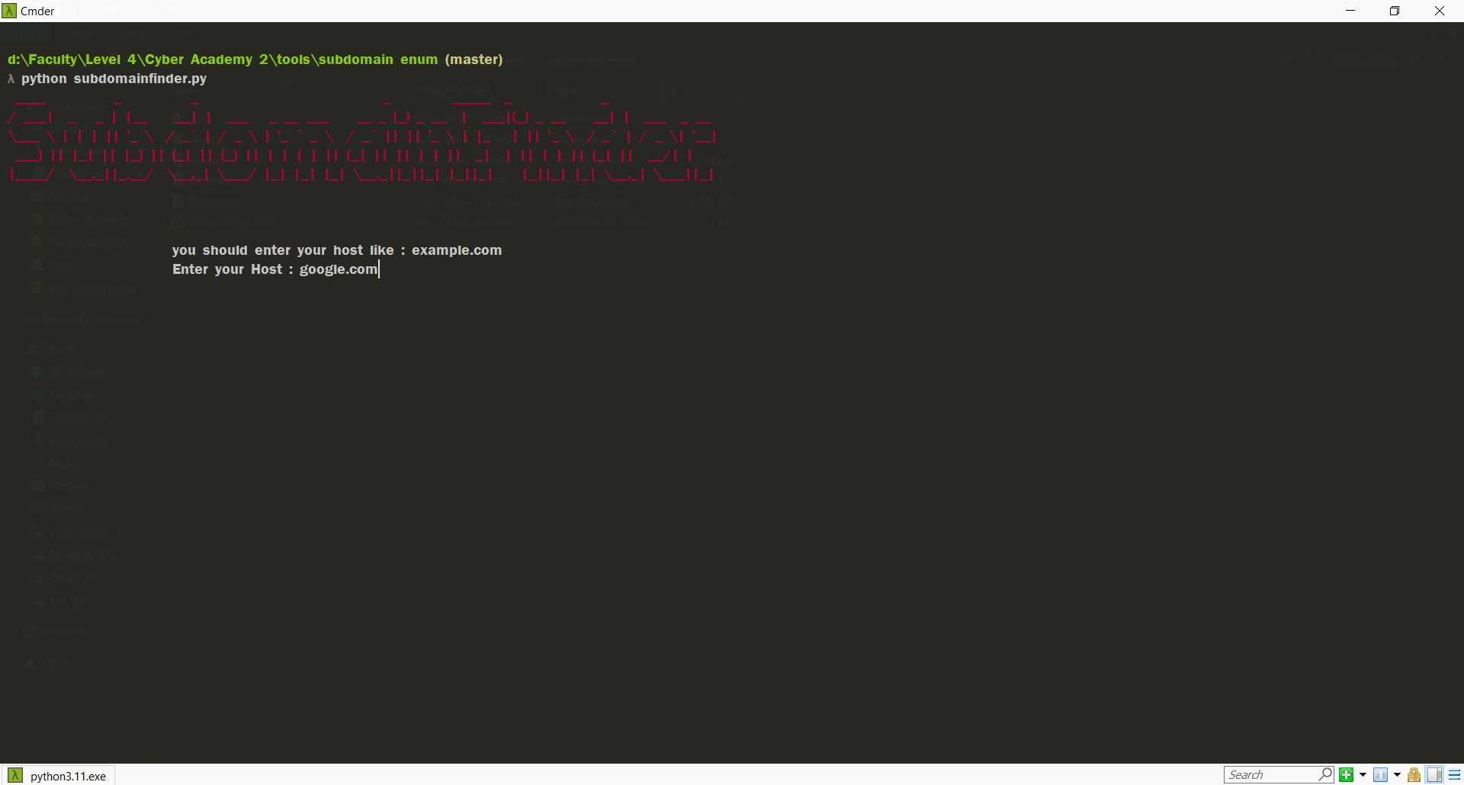

Slide 45
THANK YOU

